Slide 1

Sustainable Development Goals
IRC
4 March 2015

Slide 2
The process up to now
2012-2013: High Level Panel
  Multistakeholder
2014: Open Working Group
  17 goals and 169 targets
2014: Synthesis Report UNSG
  6 elements

Slide 3
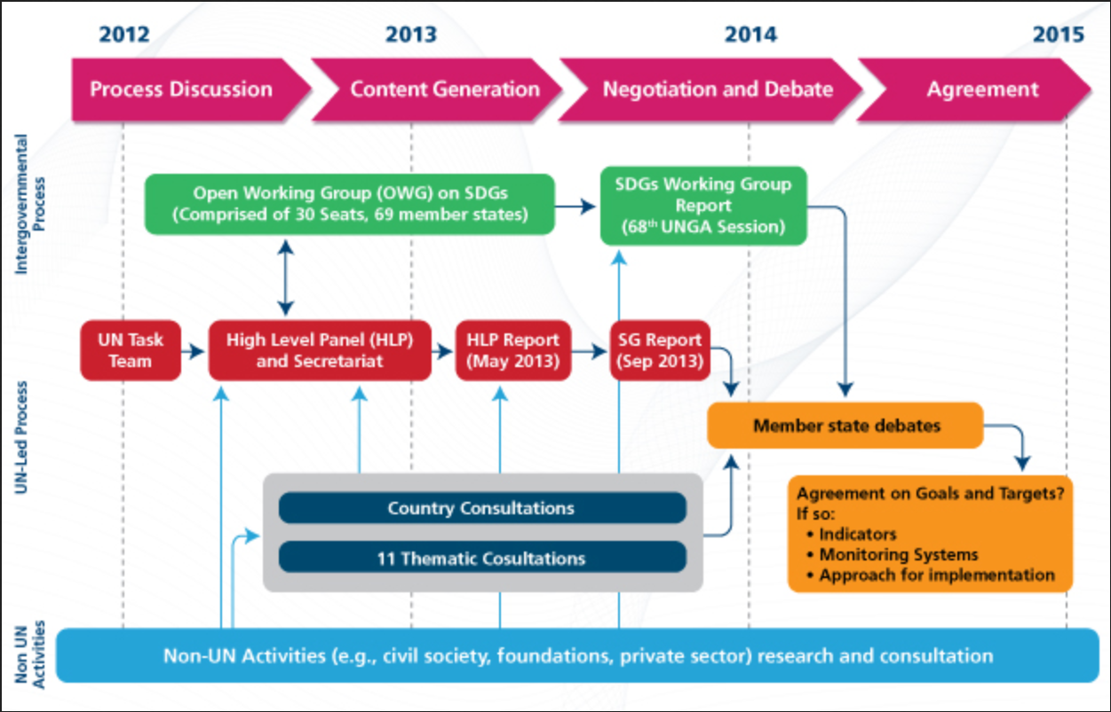
The process up to now

Slide 4
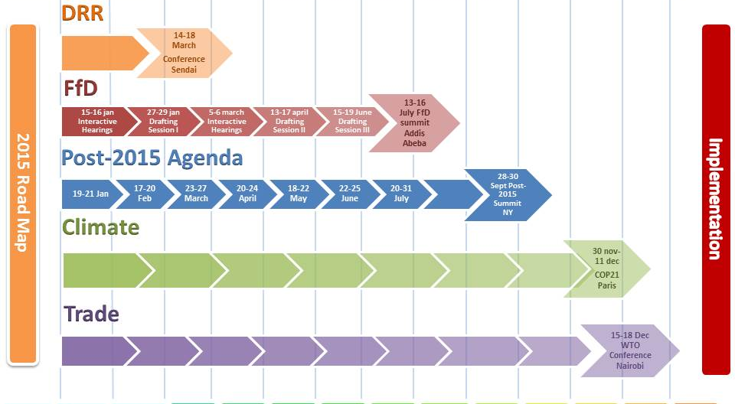
2015; an important year

Slide 5
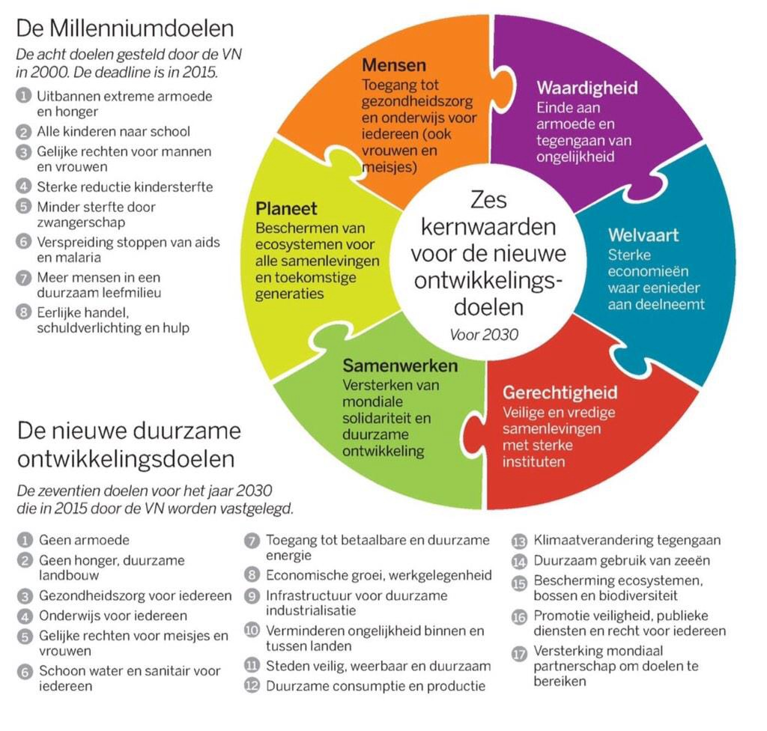
The Goals

Slide 6
What’s ahead
Now: intergovernmental negotiations
July; Addis Abeba
  Agreement on broad lines on financing the SDG’s
September; New York
  Decision on the new set of 17 goals
December; Paris
  Climate agreement
  Loose ends SDG/FfD

Slide 7
steps that will probably take place after agreement on the SDGs
Implementing the SDG’s (incl financing)
  Implementation in national policies
Monitoring progress
  Including financial commitments
Engaging other stakeholders

Slide 8


