Slide 1


Slide 2
How NOT to take a Systems Approach
How we can enable and strengthen systems change by understanding what failure means
Notes:
What do we mean by system strengthening?
Where does responsibility, accountability and blame for failure located?
How do projects contribute to (or prevent) system strengthening?
Are access to clean water and sanitation considered as different systems?
How can cross-cutting themes (buzzwords and fuzzwords?) distract from system strengthening?

Slide 3
Agenda
Session introduction [15 mins]
Stories: lessons learned [3 case studies, 20 mins]
  Climate Change
  Gender Equality and Social Inclusion (GESI)
  Economic Justice
Workshop Activity [30-35 min]
  Groups of 4-5 people
  Based on case studies
Conclusion and closure [5 min]

Slide 4
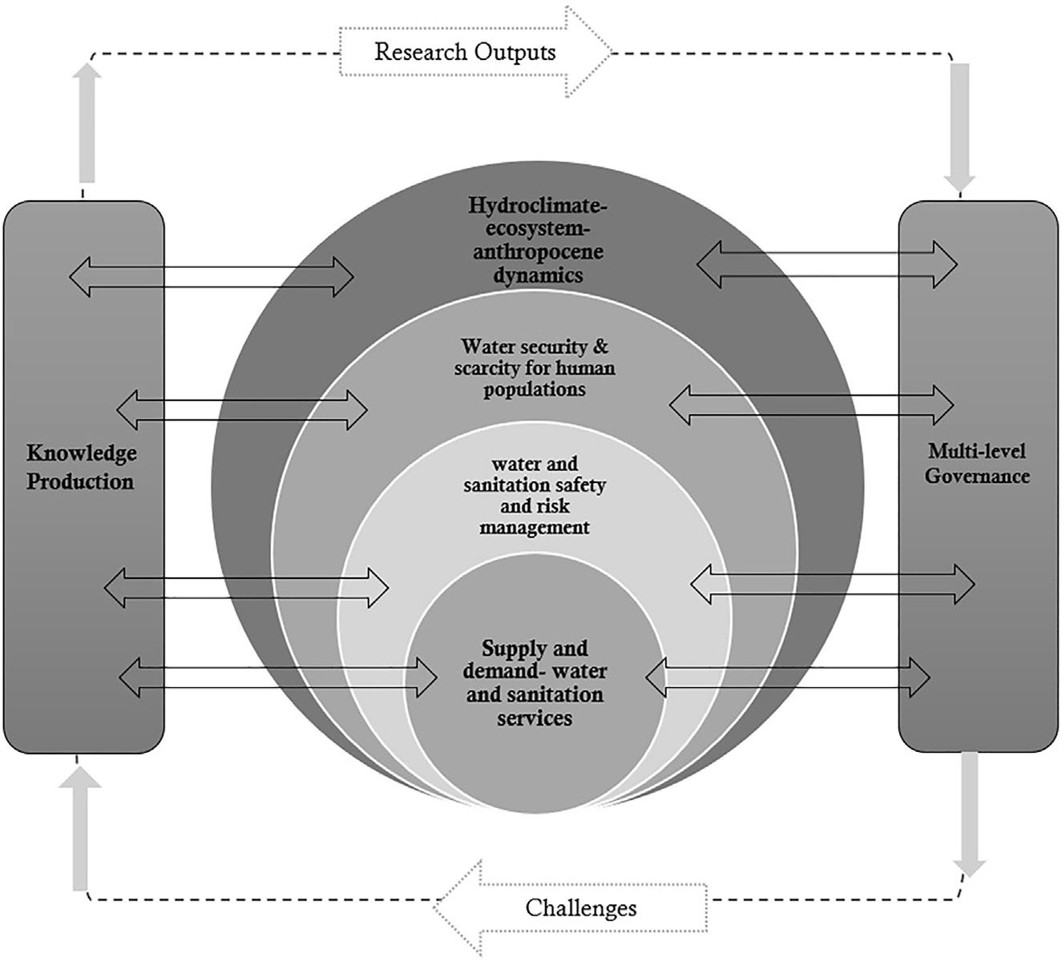
Session introduction
https://www.cell.com/one-earth/pdf/S2590-3322(22)00210-X.pdf
Notes:
how does the project link to and support wider systems strengthening (institutional capability)? Which part of the system and how? (in the intro I will start by talking about the complex wicked nature of systems strengthening across multiple institutions, scales and capabilities, politics and power etc)

Slide 5
Systems work is complex.....
“Some building is easy. Development projects have, by and large, been successful at building physical stuff: schools, highways, canals, hospitals and even building the buildings that house government ministries, courts, and agencies. But some building is hard. Anyone with experience in development knows, building capabilities of human systems including the human system called “the state”- has proven much more difficult” Andrews, Pritchett & Woolcock 2013:234
_ See work from 'Doing Development Differently' Group https://cdn.odi.org/media/documents/11199.pdf

Slide 6
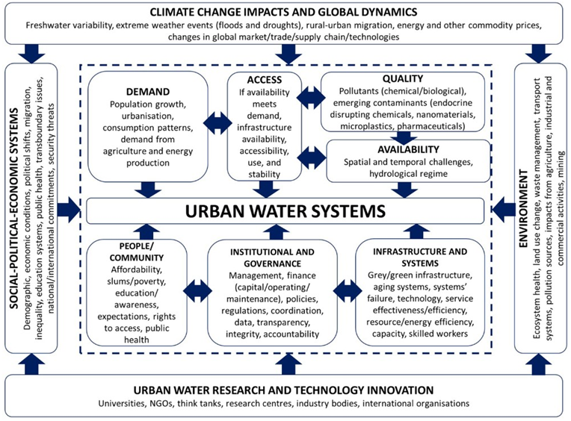
Notes:
From a recent publication..... identifying where to act.......

Slide 7
Project questions
Where and how does the project impact/build the system?
Can the impact be scaled and sustained?
Are there universal lessons or is local context critical?

Slide 8
Stories: lessons learned

Slide 9
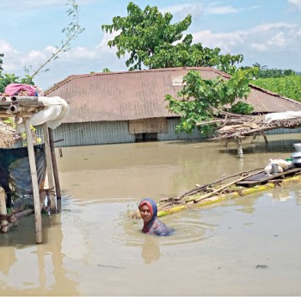
The climate conundrum: unravelling the unknown relationship between sanitation and climate change
Climate change directly affects sanitation
Sanitation contributes to climate change
Sanitation is key to resilience

Slide 10
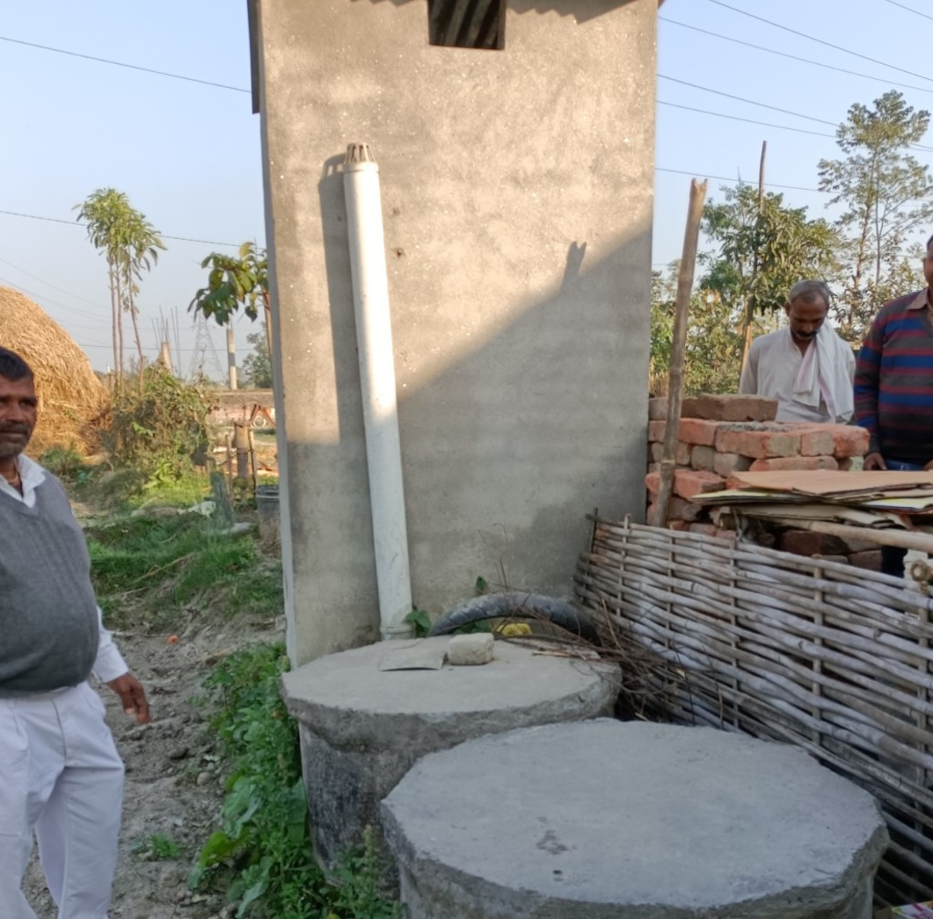
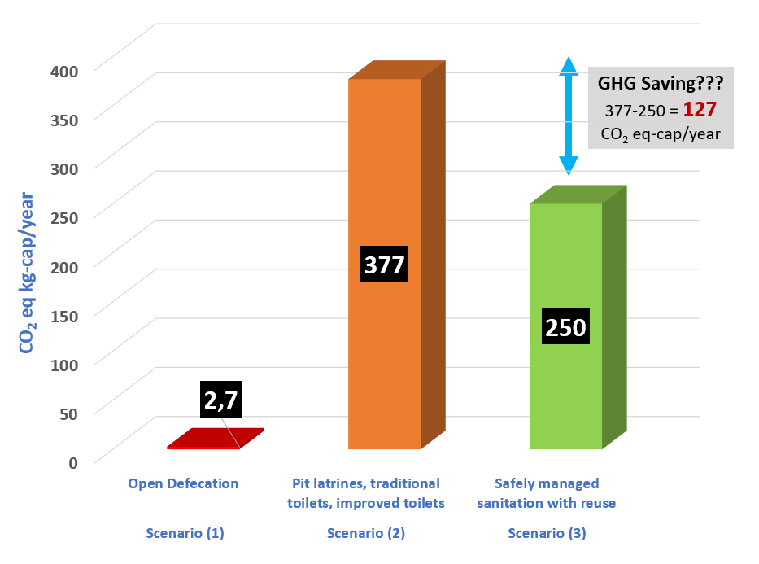
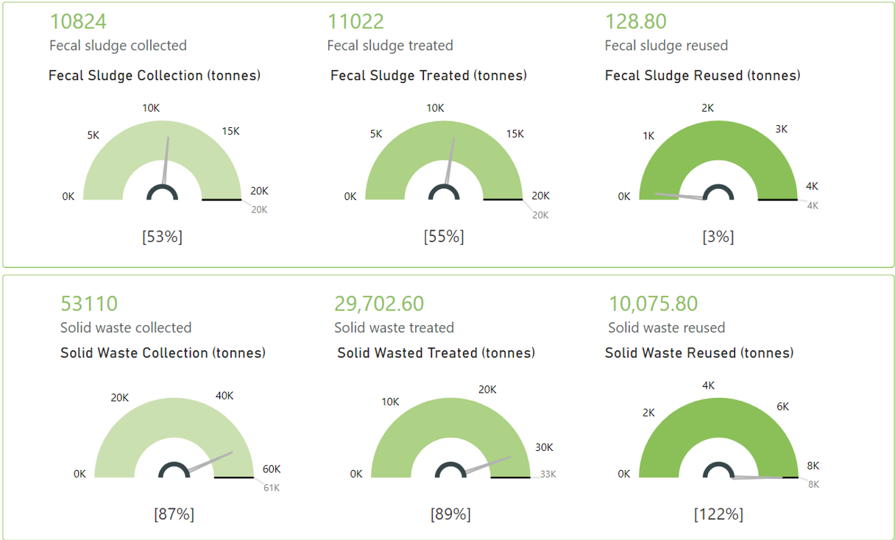
The climate conundrum: unravelling the unknown relationship between sanitation and climate change
Connecting sanitation to climate change
Limitations of system based approach hindering access to climate finance and visibility
What can be done differently?
https://www.nature.com/articles/s41558-020-0782-4
https://www.sciencedirect.com/science/article/pii/S0013935122007952

Slide 11

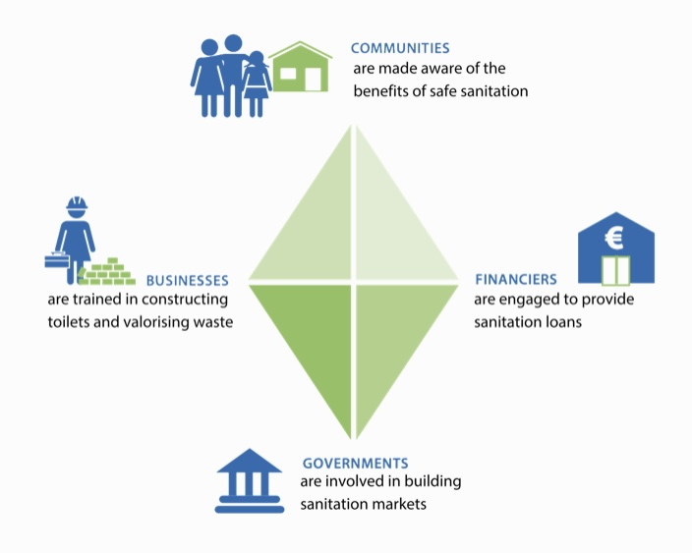
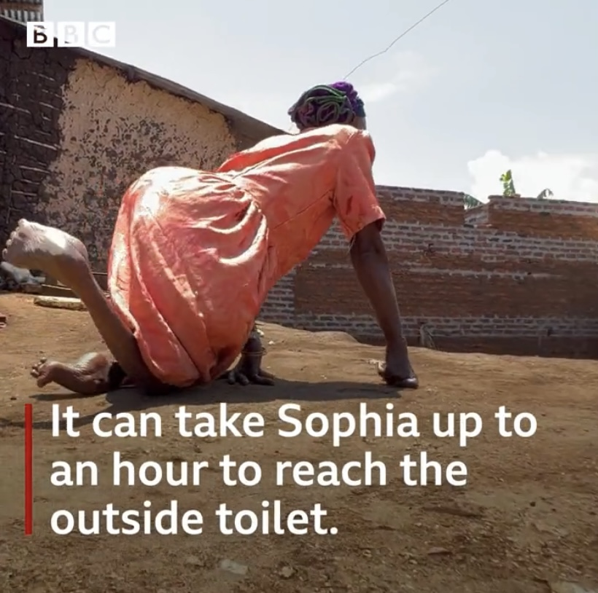
Gender equality and
social inclusion #GESI

Slide 12


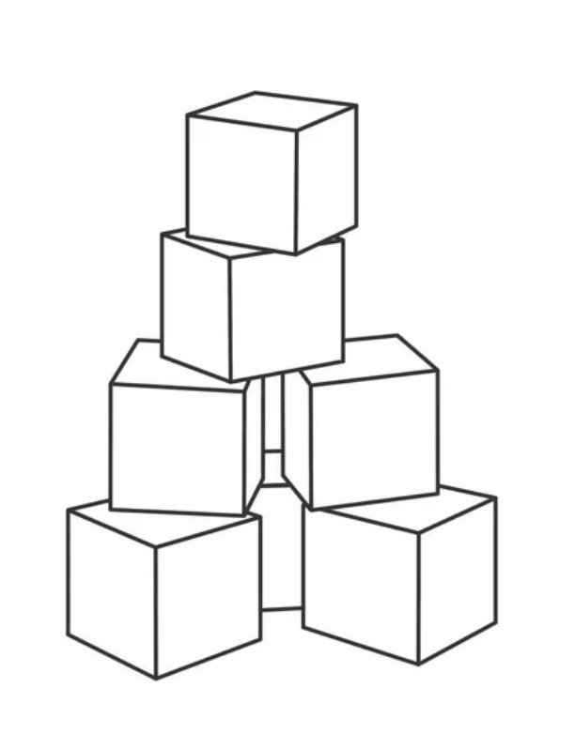

How NOT to take a system approach – lessons learned on #GESI within FINISH Mondial
#GESI is not business as usual
Do NOT only focus on low unit costs
Go for long-term partnerships
Include #GESI as a building block from the start
Make it a true collaborative partnership
incl groan zone and value clarification

Slide 13
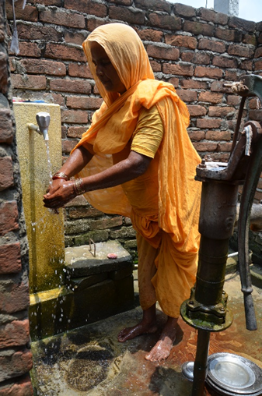
Economic justice or injustice?
Market based water – does it work in water scarce or neglected areas where 30-40% of systems are non-functional
Is financial sustainability a mark of success or does it ignore well-being?
What is the role of the market in the midst of instability and climatic change

Slide 14
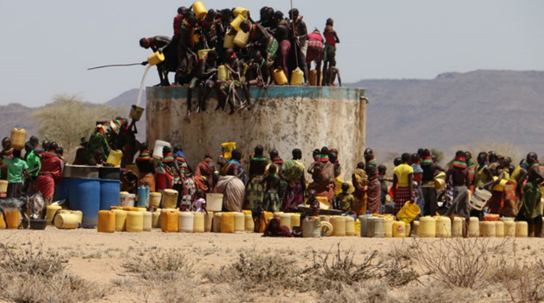
Where is the trust?

Slide 15
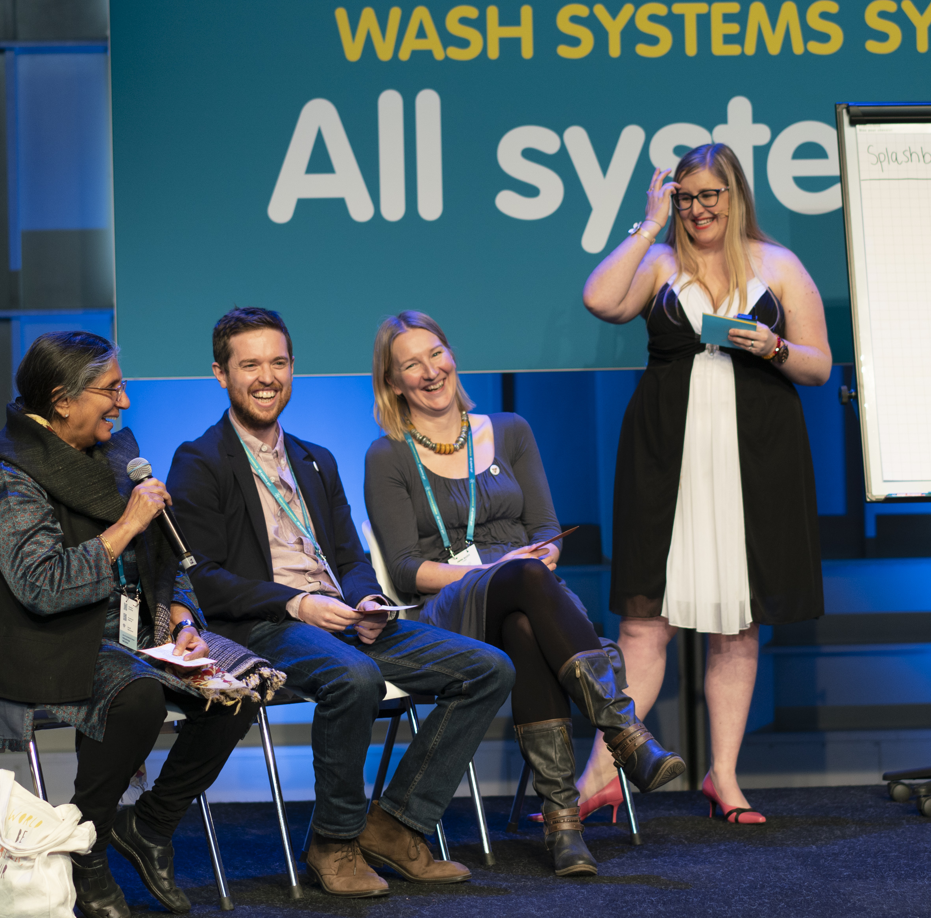
Lessons Learned
Case studies each focussed on a theme to achieve WASH objectives
What were the challenges in taking a systems strengthening approach?
System strengthening is hard! Systems are political, messy and dynamic.
Projects often fail in this regard; may prevent system strengthening.

Slide 16
Workshop
Where and how does the project impact/build the system?​
  What are the trade-offs and do themes detract from the goals or strengthen them?
Can the impact be scaled and sustained?​
  What is missing to make it scalable?
Are there universal lessons or is local context critical?
  At which level does the scale need to happen?
www.menti.com
Code 5569 2023

Slide 17
www.menti.com
Code 5569 2023

Slide 18
Conclusion & Closure
What key insight do you want to explore more after you leave this session?

