Slide 1


Slide 2


Transforming access to WASH and nutrition services, successful government systems change for decentralized WASH services

Slide 3
















INSTITUTIONAL CONTEXT
2015 2015-2020 2023
Fund Manager
Private sector
PEC to improve capacity of comunities for mng of WASH infrastructure and hyigiene practices
Financial and Tecnical Reporting
Operational costs
Supply chain of WASH products
O&M of WASH infrastructure
-Procurement
-Contract Mng
-M&E
-WASH Infrastructure
-Reporting by PECs
Procurement and delivery plan
Donor
Management of WASH infrastrucure
Quarterly reports
WASH delivery service
Systems strengthening and Capacity Bulding
Capacity Building Agent
Planning and needs
Program indicators reportng
Reporting on M&E
Rural communities
Field WASH data
Independent Monitoring Partner
Financial Transfers
Without financial transfers

Slide 4








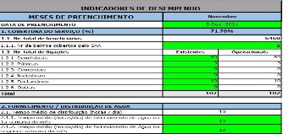

CAPACITY BUILDING NEEDS ASSESSMENT
ERRORS IN PROCUREMENT PROCESSES SUBMITTED TO ADMIN COURT AND ON SUBMITION OF PAYMENTS
GOV HR WITH LACK OF CAPACITIES AND EXPERIENCE
GOV CAPACITY BUILDING NEEDS ASSESSMENT
LACK OF EQUIPMENT
TOOLS FOR CONTRACT MANAGEMENT AND MONITORING NOT IN-PLACE
LACK OF FUNDS FOR MONITORING FIELD ACTIVITIES

Slide 5

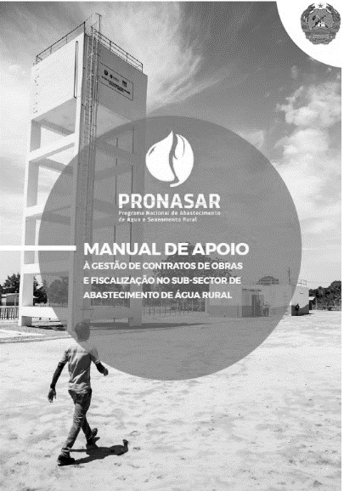

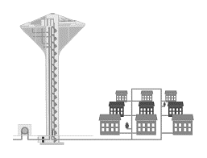



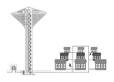

PLAN FOR STRENGTHENING GOVERNMENT CAPACITIES & SYSTEMS
IT EQUIPAMENT + VEHICLES
(Computers + Tables + Motorbikes + cars)
CAPACITY BUILDING
TRAINING MANUALS
(PROCUREMENT + CONTRACT MANAGEMENT)
HORIZONTAL LEARNING BETWEEN DISTRICTS AND PROVINCES
MONITORING TOOLS FOR WASH SERVICES
(SMS + CLIMATE RESILIENCE ASSESSMENT)
STANDARD TRAININGS (PARTNERSHIP WITH PUBLIC ENTITIES)
TECHNICAL ASSISTANCE EXPERTISE ON CONTRACT MANAGEMENT OF WASH SERVICES

Slide 6


PLAN FOR STRENGTHENING GOVERNMENT CAPACITIES & SYSTEMS
OPERATIONAL FUND FOR MONITORING + OVERSIGNTING
FUND MANAGEMENT SUPPORT
TRAINING TOOLS
FOR FUND MANAGEMENT (Procedures Manual + video + Online platform)
STANDARD TRAININGS ON PAYMENT PROCESSS
ON THE JOB-TRAININGS + FOLLOW UP MISSIONS

Slide 7
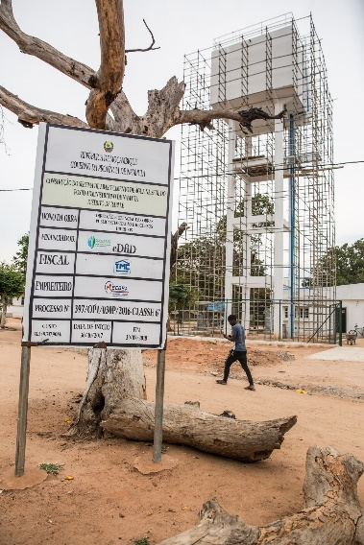
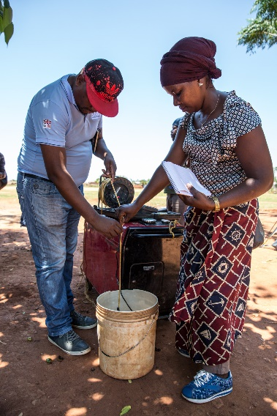
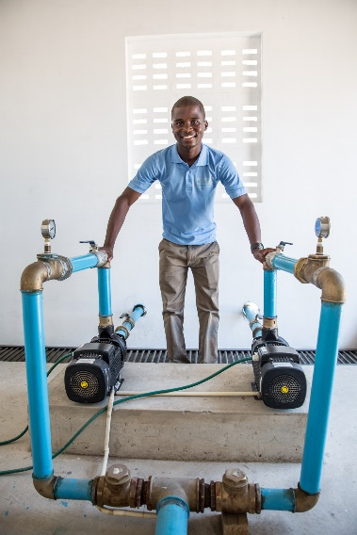


PROGRAM MAIN RESULTS
41
18.5 Mi
250
90%
200.000
USD INVESTED ON NEW WSS
TRAINED TECHNICIANS
FEWER RETURNS ON PROCUREMENT PROCESSES FROM ADMINISTRATIVE COURT
Completed Water Supply System
PEOPLE WITH ACESS TO Water Supply SERVICES

Slide 8




WAY FORWARD
1
2
3
ENSURE QUALIFIED TECHNICAL TEAMS
STRENGTHEN DECENTRALIZATION PROCESS + ENGAGE LOCAL STAKEHOLDERS
REINFORCING THE CLIMATE RESILIENCE APPROACH FOR WASH SERVICES
4
5
IMPROVE FINANCIAL RESOURCES
SUPPORT REVIEW PROCESS OF REGULATION FOR WASH SERVICES.

